Slide 1
18ECC203J – Module 1 Intel 8086 – Architecture, Signals and Features S – 3
Prepared by,
Dr. R. Manohari
Dr.T.Rajalakshmi

Slide 2
S – 3 Architecture of 8086

Slide 3
Functional blocks
Microprocessor
Computational Unit; performs arithmetic and logic operations
Various conditions of the results are stored as status bits called flags in flag register
Internal storage of data
Register array or internal memory
Data Bus
ALU
Generates the address of the instructions to be fetched from the memory and send through address bus to the memory
Flag Register
Instruction decoding unit
Timing and control unit
PC/ IP
Control Bus
Address Bus
Generates control signals for internal and external operations of the microprocessor
Decodes instructions; sends information to the timing and control unit

Slide 4
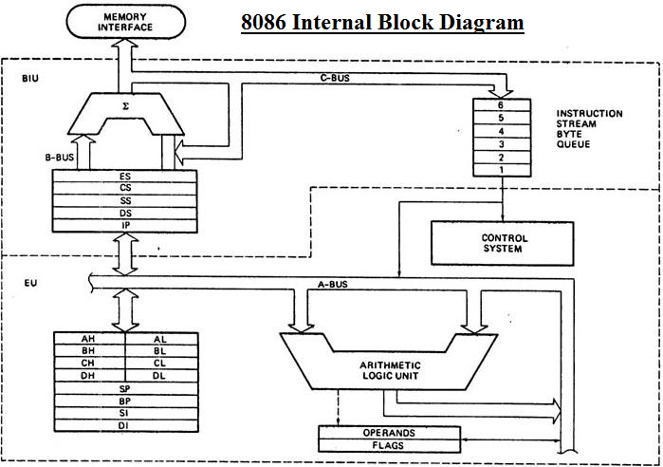

Slide 5
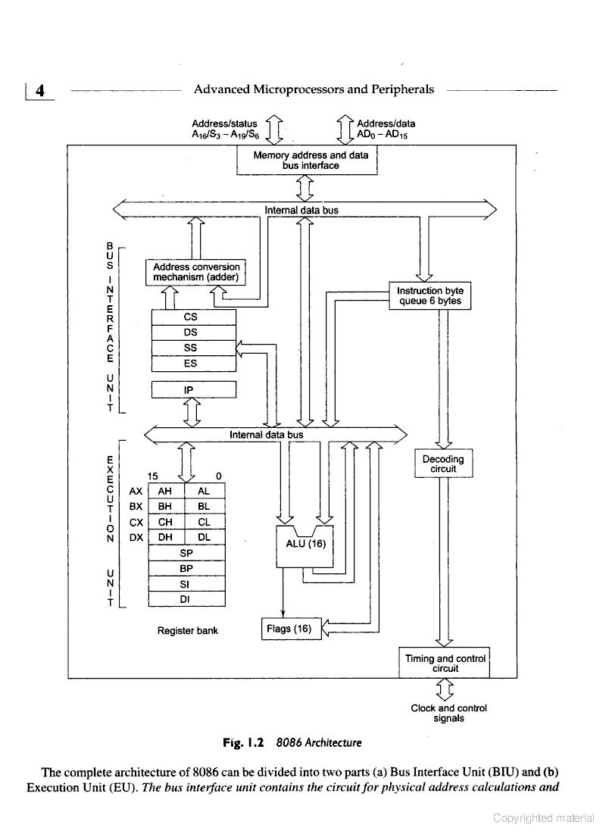
Architecture of 8086

Slide 6
8086 Internal Architecture
The complete architecture is divided into two parts:
Bus Interface Unit
Execution Unit

Slide 7
8086 Internal Architecture
BIU: It sends out addresses, fetches instructions from memory, reads data from ports and memory and writes data to ports and memory.
EU: It tells the BIU where to fetch instructions or data from, decodes instructions and executes instructions

Slide 8
Bus Interface Unit
BIU contains
Instruction Byte Queue (6 bytes long)
Segment Registers
Instruction Pointer
Circuit for physical address calculations

Slide 9
Segment Registers (S – 2)
Four Segment registers in the BIU are used to hold the upper 16 bits of the starting addresses of four memory segments that the 8086 is working with at a particular time

Slide 10
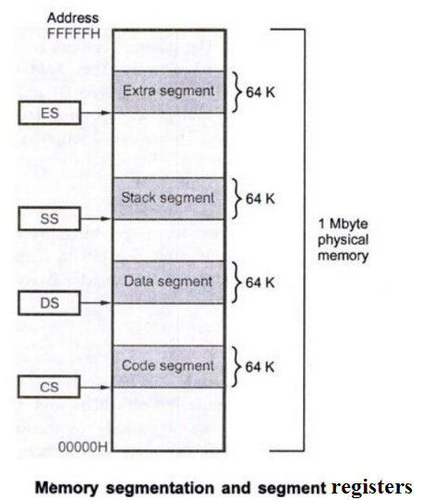
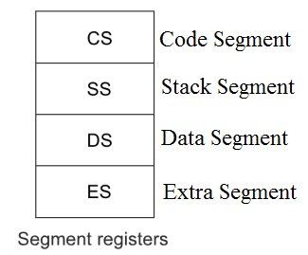
Segment Registers (S – 2)
Unlike 8085, the 8086 addresses a segmented memory
A segment register points to the starting address of a memory segment.

Slide 11
Segment Registers (S – 2)
Code Segment Register: Used to hold the upper 16 bits of the starting address of code segment from which the BIU is currently fetching instruction code bytes
Data Segment Register & Extra Segment Register: Used to hold the upper 16 bits of the starting addresses of data segment and extra segment that are used for data
Stack Segment Register: Used to hold the upper 16 bits of the starting addresses of stack segment which is used to store stack data

Slide 12
The Queue Operation

Slide 13
Queue Operation cont…
The 8086 has a 6-byte instruction prefetch queue.
Thus even the largest (6-byte) instruction can be prefetched from the memory and stored in the prefetched queue.
This results in a faster execution of the instruction.
In the beginning, the CS:IP is loaded with the required address from which the execution is to be started.
Initially, the queue will be empty and the microprocessor starts a fetch operation to bring one byte (the first byte) of instruction code, if the CS:IP address is odd or two bytes at a time, if the CS:IP address is even.
When the first byte from queue goes for decoding and interpretation, one byte in the queue becomes empty and subsequently the queue is updated.
The microprocessor does not perform the next fetch operation till at least two bytes of the instruction queue are emptied.

Slide 14
Queue Operation cont…
The queue is updated after every byte is read from the queue but the fetch cycle is initiated by BIU only if at least two bytes of the queue are empty and the EU may be concurrently executing the fetched instructions.
The next byte after the instruction is completed is again the first opcode byte of the next instruction.
A similar procedure is repeated till the complete execution of the program.
The fetch operation of the next instruction is overlapped with the execution of the current instruction.
While the execution unit is busy in executing an instruction, after it is completely decoded, the bus interface unit may be fetching the bytes of the next instruction from memory, depending upon the queue ststus.

Slide 15
Execution Unit
It contains:
Control Circuitry
Instruction Decoder
Arithmetic Logic Unit (ALU)
Flag Register
General Purpose Registers
Pointers and Index Registers

Slide 16
Control Circuitry, Instruction Decoder, ALU
Control Circuitry in the EU directs the internal operations
A Instruction decoder translates instructions fetched from memory into a series of actions which the EU carries out
16 bit arithmetic logic unit can add, subtract, AND, OR, XOR, increment, decrement, complement or shift binary numbers

Slide 17
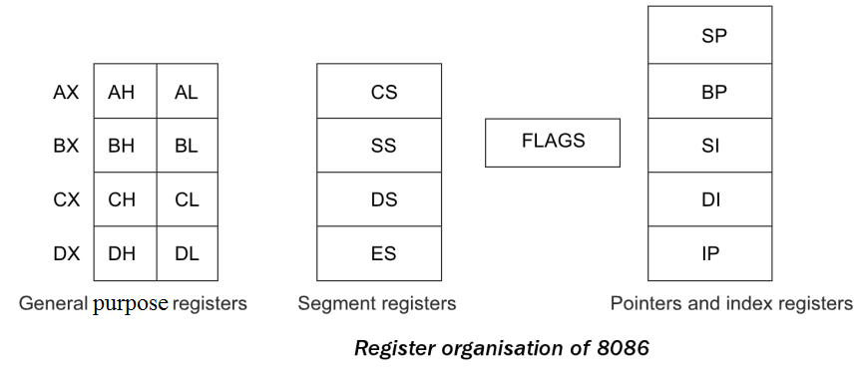
Register Organization of 8086

Slide 18
Flag Register (S – 2)
A flag is a flip-flop that indicates some condition produced by the execution of an instruction or controls certain operations of the EU
A 16-bit flag register in the EU contains nine active flags in the flag register

Slide 19
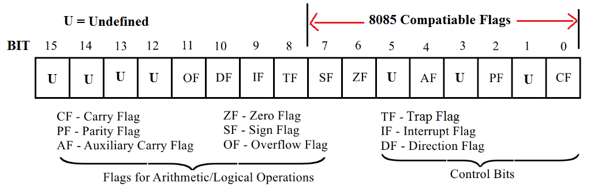
Flag Register (S – 2)
8086 has 9 flags and they are divided into two categories:
Condition Flags
Control Flags

Slide 20
Condition Flags (S – 2)
Condition flags represent result of last arithmetic or logical instruction executed. Conditional flags are as follows:
Carry Flag (CF): This flag is set if there is a carry / borrow after an integer arithmetic.
Auxiliary Carry Flag (AF): If an operation performed in ALU generates a carry / borrow from lower nibble (i.e. D₀ – D₃) to upper nibble (i.e. D₄ – D₇), then AF is set. It is used in BCD Addition.
Parity Flag (PF): This flag is used to indicate the parity of result. If the result contains even number of 1’s, the Parity Flag is set and for odd number of 1’s, the Parity Flag is reset

Slide 21
Condition Flags (S – 2)
Zero Flag (ZF): It is set; if the result of arithmetic or logical operation is zero else it is reset.
Sign Flag (SF): In sign magnitude format, the sign of number is indicated by MSB bit. If the result of operation is negative, sign flag is set.
Overflow Flag (OF): It occurs when signed numbers are added or subtracted. An OF indicates that the result has exceeded the capacity of machine that is result is out of range

Slide 22
Control Flags (S – 2)
Control flags are set or reset deliberately to control the operations of the execution unit. Control flags are as follows:
Trap Flag (TP):
It is used for single stepping through a program
It allows user to execute one instruction of a program at a time for debugging.
When trap flag is set, program can be run in single step mode.

Slide 23
Control Flags (S – 2)
Interrupt Flag (IF):
It is an interrupt enable / disable flag.
If it is set, the INTR interrupt of 8086 is enabled and if it is reset then INTR is disabled.

Slide 24
Control Flags (S – 2)
Directional Flag (DF):
It is used with string operations.
If it is set, string bytes are accessed from higher memory address to lower memory address.
When it is reset, the string bytes are accessed from lower memory address to higher memory address.

Slide 25
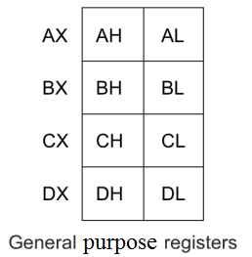
General Purpose Registers (S – 2)
EU has eight general purpose registers, labeled AH, AL, BH, BL, CH, CL, DH & DL
These registers can be used individually for temporary storage of 8-bit data.
The AL register is also called the accumulator
Certain pairs of these general purpose registers can be used together to store 16-bit data words
AH-AL pair --- AX register
BH-BL pair --- BX register
CH-CL pair --- CX register
DH-DL pair --- DX register

Slide 26
General Purpose Registers (S – 2)
AX Register: AX register is also known as accumulator register that stores operands for arithmetic operation like divided, rotate.
BX Register: This register is used as an offset storage for forming physical addresses in case of certain addressing modes.
CX Register: It is used as a default counter in case of string and loop instructions.
DX Register: DX register is used to contain I/O port address for I/O instruction.

Slide 27
Pointer and Index Registers (S – 2)
Stack Pointer (SP)
Base Pointer (BP)
Source Index (SI)
Destination Index (DI)

Slide 28
Pointer and Index Registers (S – 2)
Stack Pointer (SP):
The function of SP is same as the function of SP in Intel 8085.
It stores the address of top element in the stack.
BP, SI & DI are used
for temporary data storage just as the general purpose registers
in memory address computation. (later)

Slide 29
Base Pointer (BP), Source Index (SI), Destination Index (DI) Registers (S – 2)
BP : We can use it instead of SP for accessing the stack using based addressing mode.
In this case, the 20-bit physical stack address is calculated from BP and SS
SI : It can be used to hold the offset of source data in the data segment
In this case, the 20-bit physical data address is calculated from SI and DS
DI: It is used to store the offset of destination in data or extra segment
String instructions always use ES and DI to determine the 20-bit physical address for the destination

Slide 30
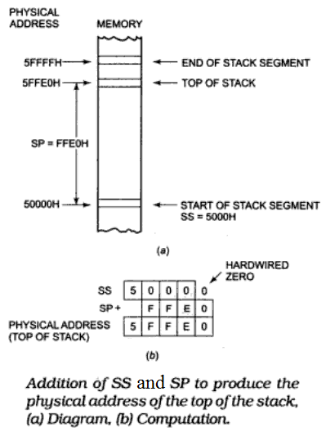
Stack Pointer Register (S – 2)
The SP register in the EU holds the 16-bit offset from the start of the stack segment to the top of the stack
For stack operation, the content of the SS register and the content of the SP register are used to produce the 20-bit physical address.

Slide 31
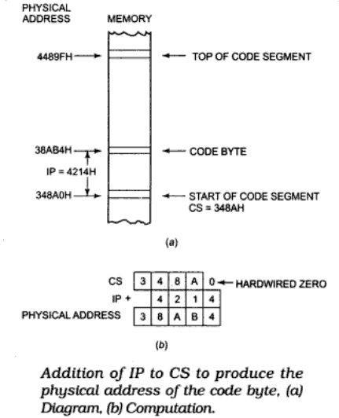
Instruction Pointer (IP) (S – 2)
The Instruction Pointer (IP) in 8086 acts as a Program Counter.
IP register holds the 16-bit address or offset of the next code byte within the code segment
The value contained in the IP is referred to as an offset because the 20-bit physical code byte address is calculated from IP and CS

Slide 32
Cont. (S – 2)
The instruction pointer register contains a 16-bit offset which tells, where in that 64-Kbyte code segment the next instruction byte is to be fetched from.

Slide 33
Thank You

